Slide 1
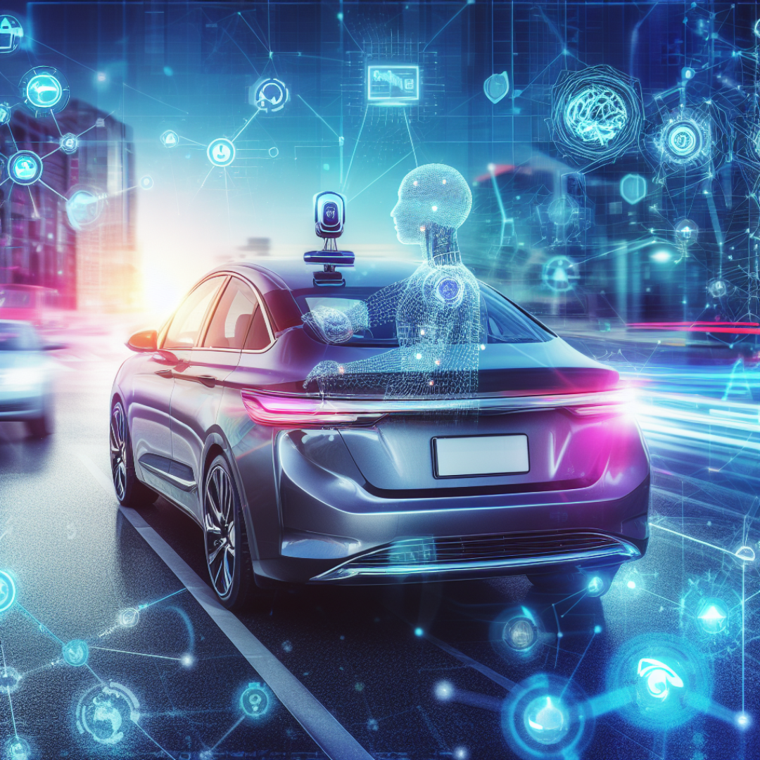
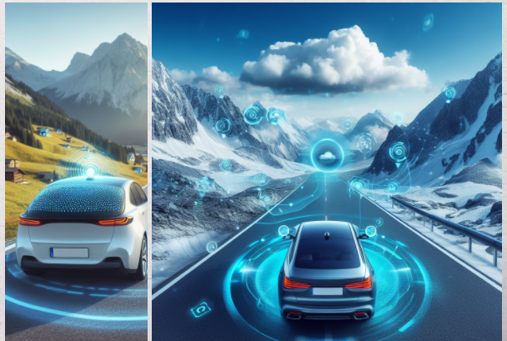
Intelligent Agents
Intelligent agents are AI systems capable of perceiving their environment, making decisions autonomously, and taking actions. Intelligent agents often designed for specific tasks or domains. For example, self-driving cars use intelligent agents to control the car and navigate the road.

Slide 2
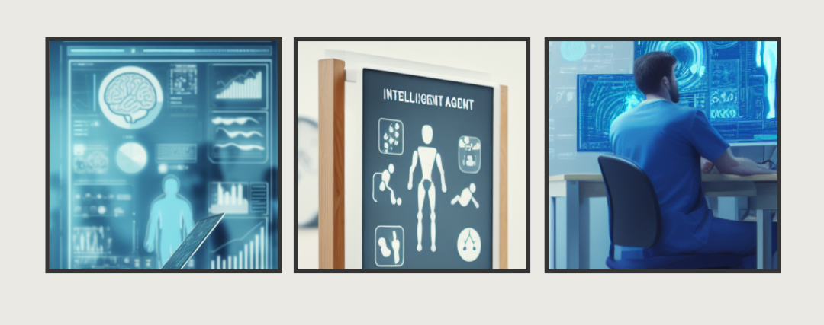
In Healthcare
Intelligent agents-powered exoskeletons can help people with mobility impairments to walk and move around more easily.

Slide 3
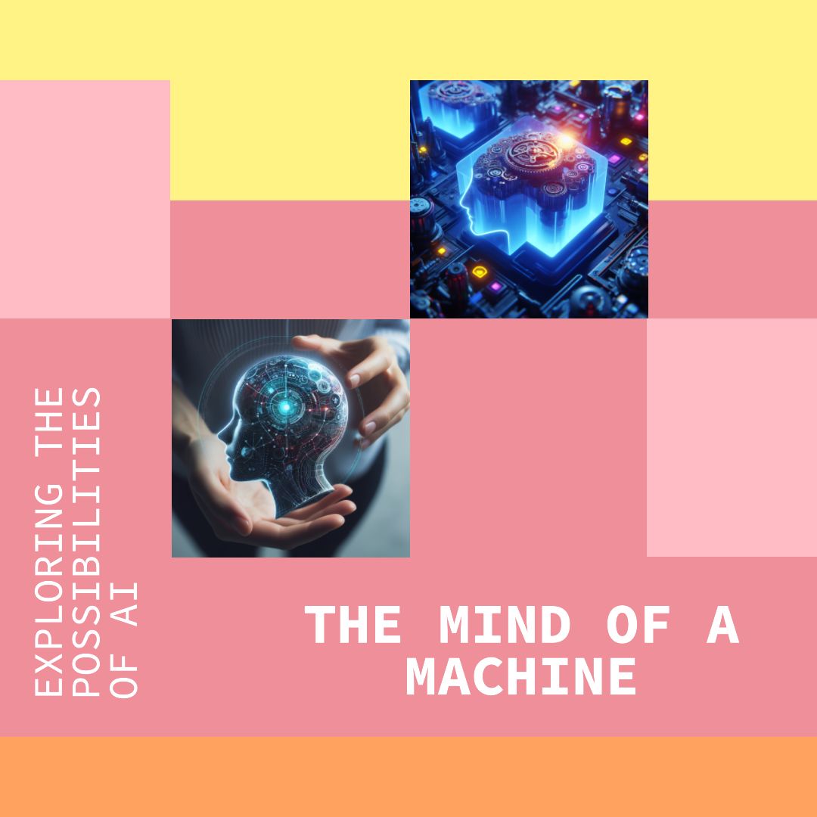
Intelligent Agents are steppingstones and building blocks towards achieving the theory of Artificial General Intelligence. As we develop more sophisticated intelligent agents, we are gradually moving closer to the goal of creating truly intelligent machines.

